Slide 1
CP3402 / CP5637 Content Management Systems
Week 09
UX - User Experience
Reference: Web UI Design for the Human Eye from UXPin.com

Slide 2
Learning Objectives
Appraise the role of content management technologies to acquire, organise and present web content
Understand various psychological principles about how people think and process visual information
Be able to use various user interface and user interaction design techniques to create effective websites
Perform iterative testing to improve website designs

Slide 3
Assignment Marking
Goal-Driven | Goals of the site are clearly evident in the design and calls-to-action are well used | Design leads user toward site goals but not as well as it should; only some calls-to-action are evident | Design has some goal-orientation, but mostly misses the opportunities to lead users; calls-to-action are not evident | There is no sense of the site design being goal-driven
Information Architecture | Content has been thoughtfully organised to be suitable for site goals; navigation is intuitive | Content is mostly well-organised; navigation is mostly not always intuitive | Not all content is well-organised; navigation is not intuitive | Content placement seems illogical; navigation is difficult
Information Design | Text has been formatted to be suitable for scanning and for site goals; images enhance meaning of text | Most content is well-formatted but some text needs to be made more scannable; images mostly help | Some content is well-formatted but not all; images are not well-used | No evidence of thoughtful information design; content appears to be untreated
Interface Design (custom theme) | Design is professional, consistent, suitable for site goals and audience | Design is fairly good, not as suitable for site goals and audience as it should be, inconsistencies across different pages | Design is not suitable for site goals and audience, obvious inconsistencies across different pages | Poor quality, not suitable for site goals and audience, or not using custom theme
Notes:
This shows the parts of the project assessment that this lecture is relevant to

Slide 4
User-Centred Design
Determine who you want to optimise the site for
Develop a persona for them
Attributes, values, goals, concerns
Design the site for that persona - for one person
Keep your designs simple and goal-driven
For each element, ask if it is helping or hindering the goal
Keep your designs consistent
Have the same response whenever people perform an action
Keep your designs standard
Familiar designs are easier for people to learn and use

Slide 5
User Interface Design
Gestalt principles - German word for shape or form
Aristotle: “The whole is greater than the sum of its parts”
Gestalt psychologist Kurt Koffka: “The whole is other than the sum of the parts” - not necessarily greater, but something else

Slide 6
What do you see?

Slide 7
Gestalt Principles - Emergence
When trying to identify an object, we first identify the outline, and then match it to outlines we already know.
Shapes and contours should take precedence over lesser details

Slide 8
What do you see?

Slide 9
Gestalt Principles - Reification
Our brains fill in the gaps of visual stimuli.
As long as you have enough to communicate an object, the user can fill in the rest. This allows for creative use of white space

Slide 10
Most Useful Gestalt Principles
Similarity
Figure-Ground Relationship
Grouping
Closure
Continuation

Slide 11
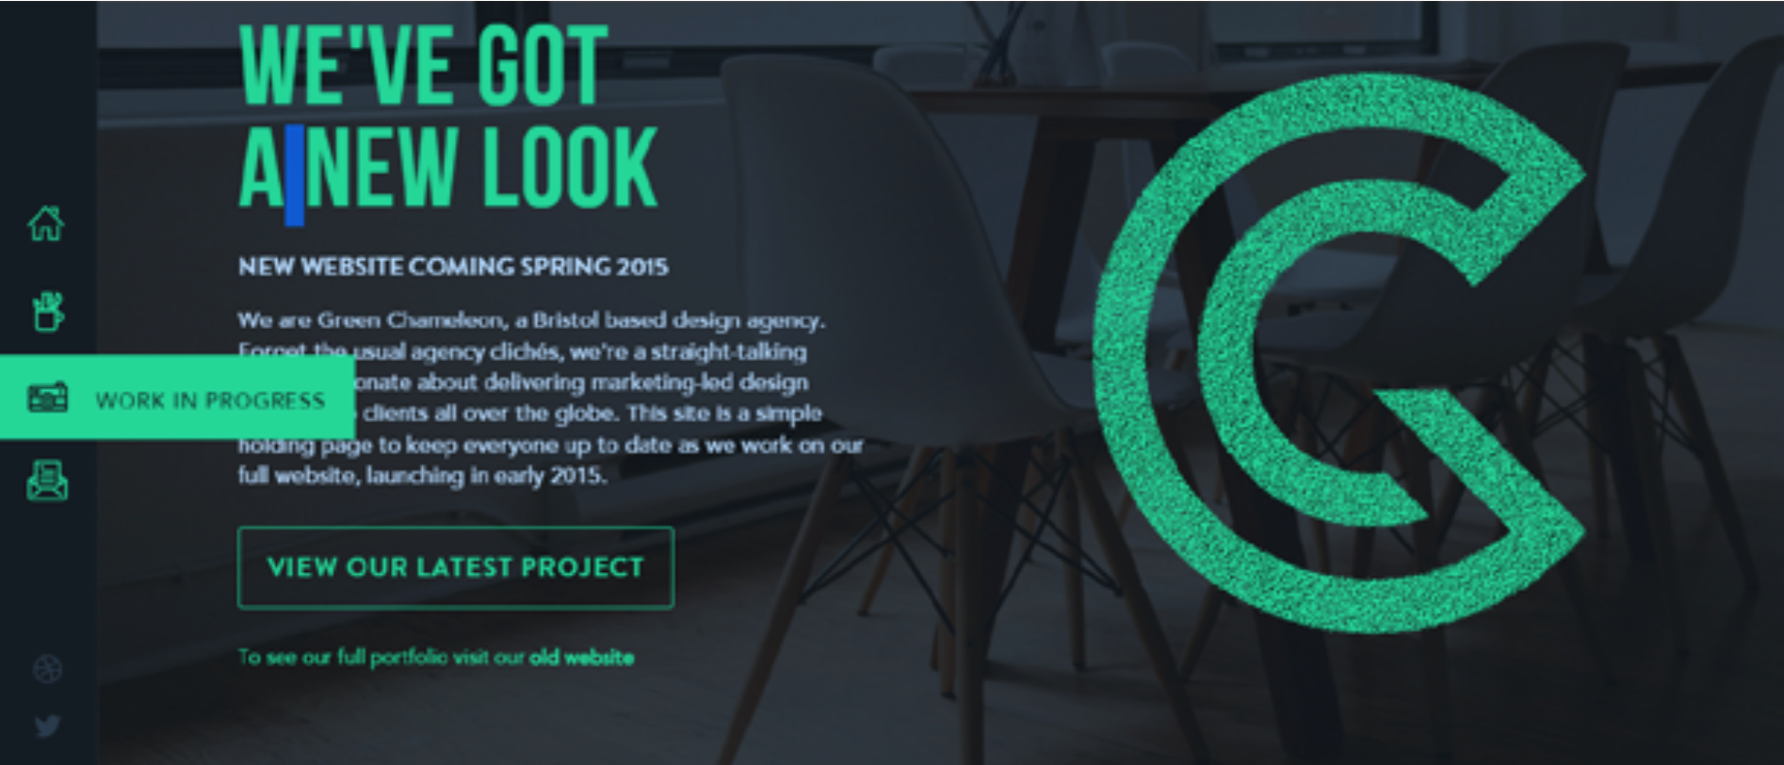
Similarity
Objects that look similar are perceived as similar

Slide 12
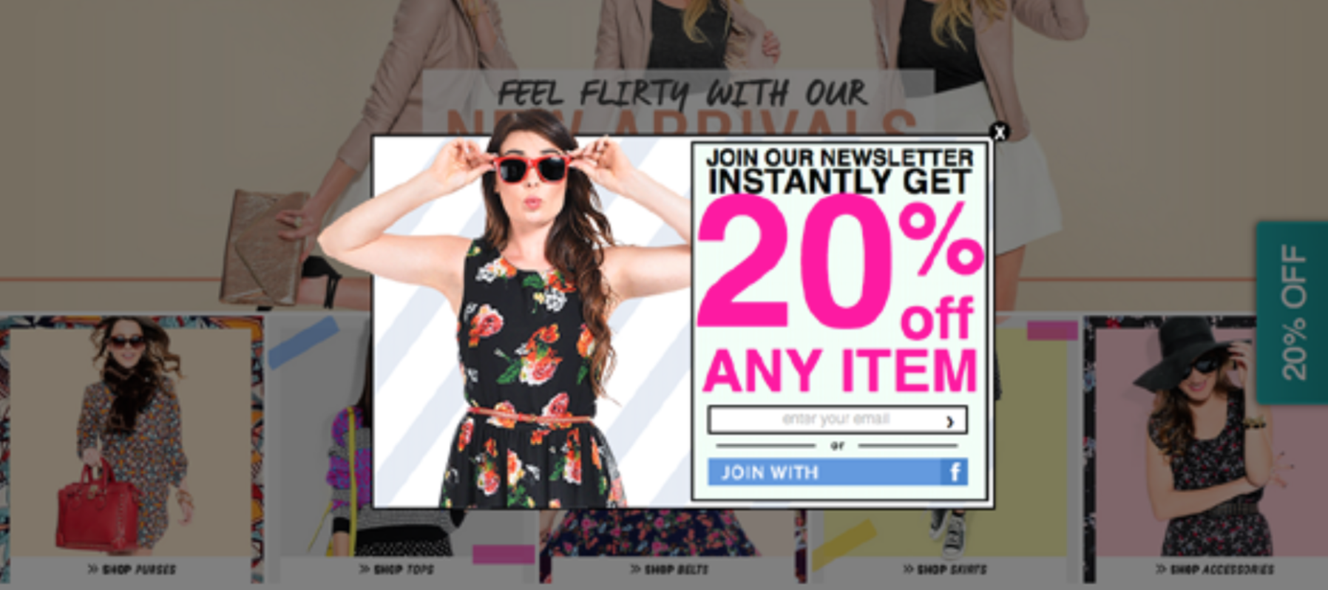
Figure-Ground Relationship
Elements are perceived as either figures (distinct elements of focus) or grounds (the background on which the figures lie)

Slide 13
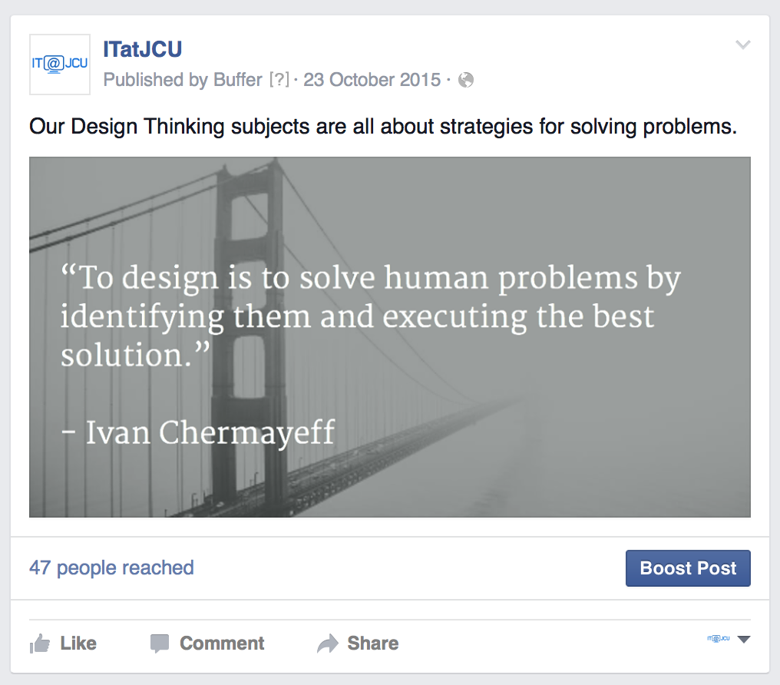
Grouping
Items that are dissimilar can still be grouped together to appear similar.
Enclosure
Proximity

Slide 14
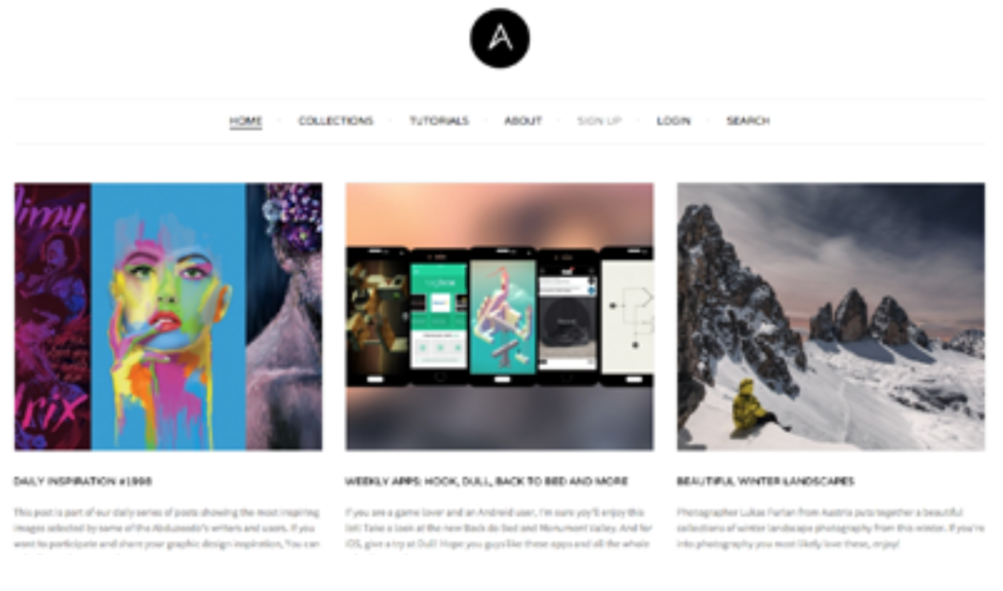
Closure
Users will provide their own closure to incomplete objects by filling in the gaps (mentally) themselves
Allows for partial designs, and encourages minimalist styles that communicate elegance
http://images.thoughtbot.com/gestalt-principles-blog-post/closure-shopping-cart.gif

Slide 15
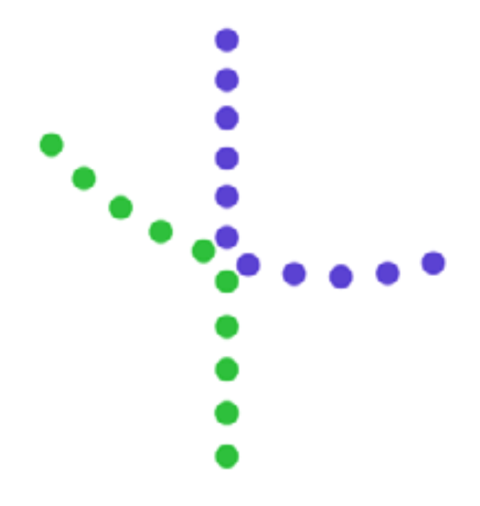
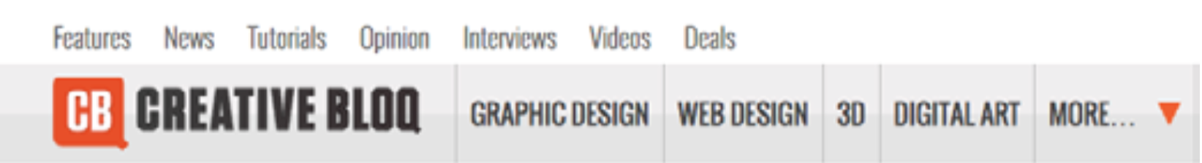
Continuation
A user’s eye creates momentum as it moves from object to object, giving lines a special power in layout design

Slide 16
What’s the point?
Understanding Gestalt principles:
gives you greater control over your visual hierarchy,
helps create more harmonious designs, and
increases the likelihood that your message is communicated to your audience.
Combining the principles will raise your level of visual design.

Slide 17
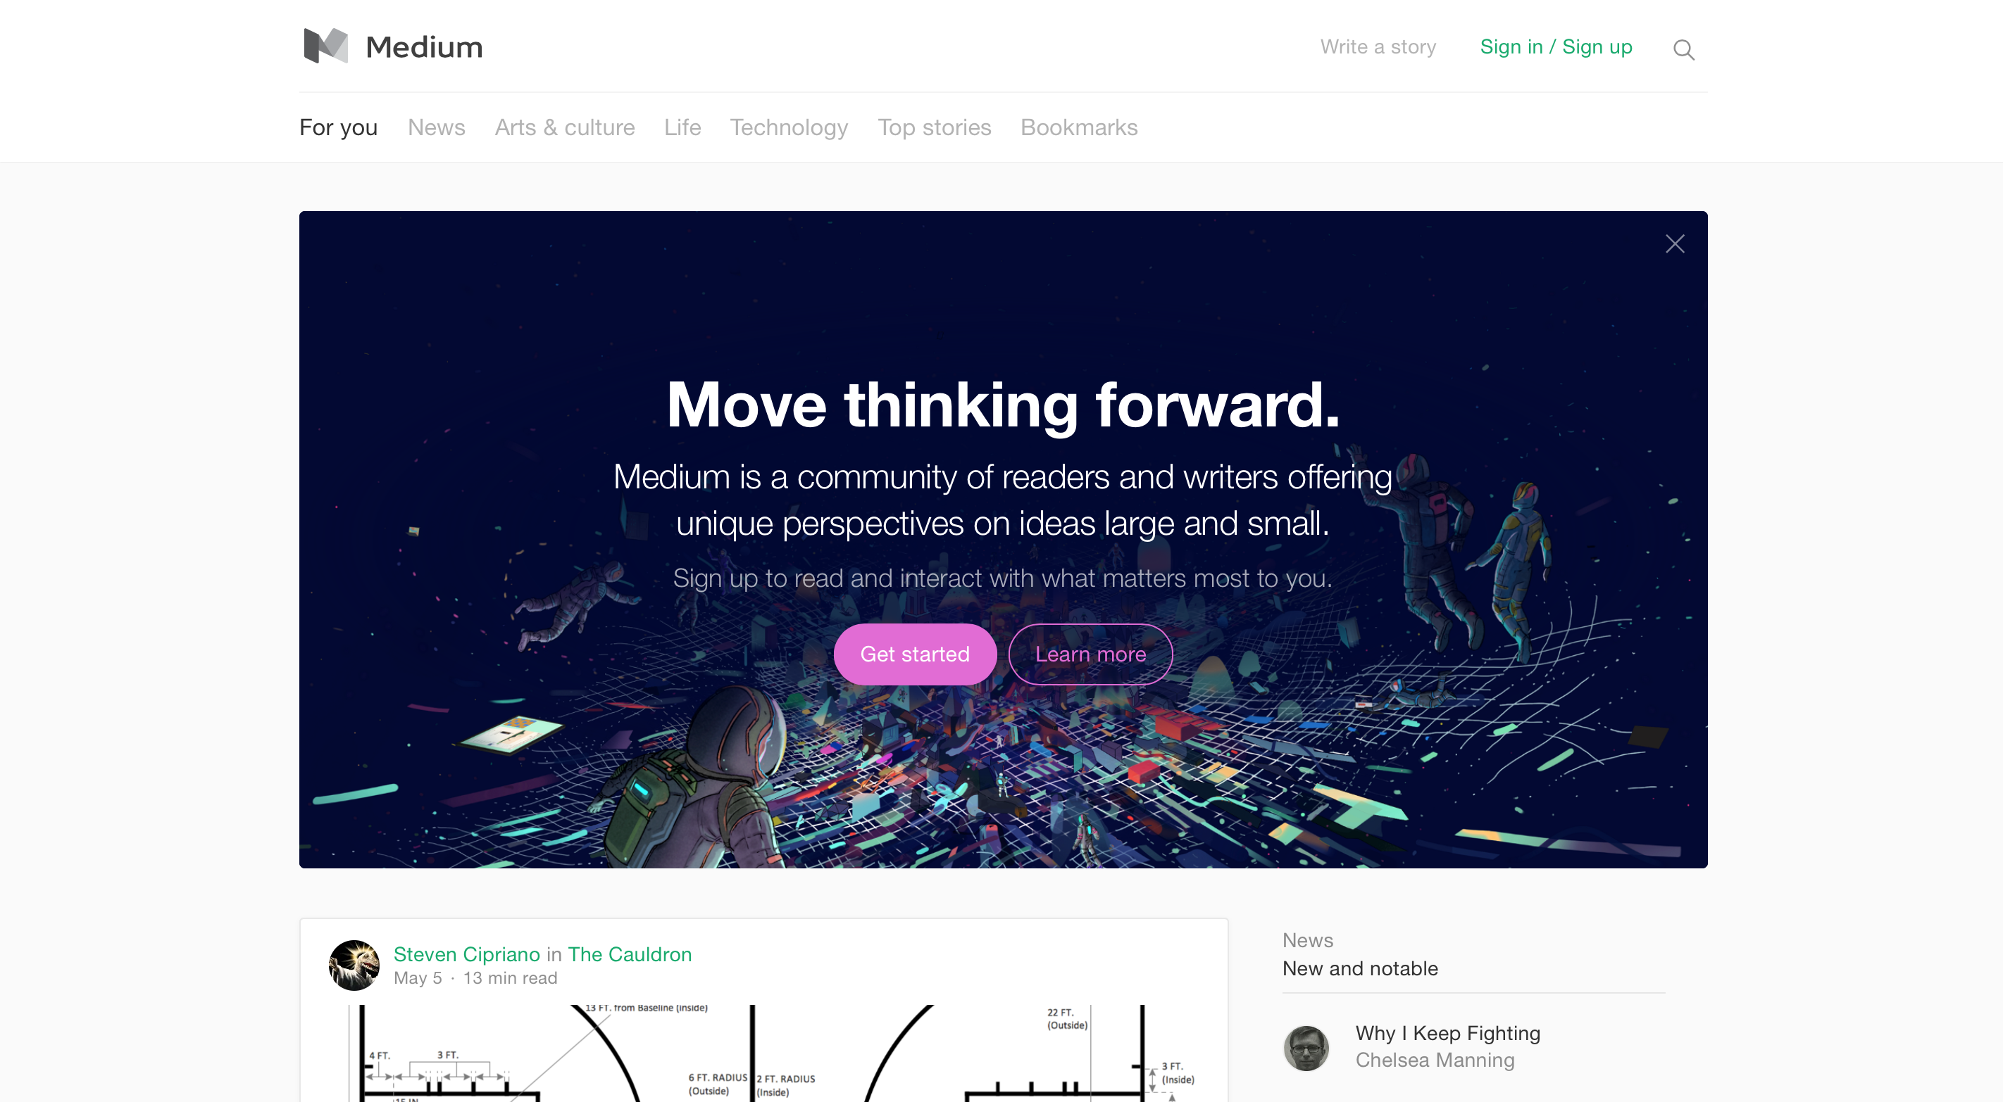
Use White Space Effectively
In interaction design, white space serves three main functions:
improving comprehension
clarifying relationships
drawing attention
Compare: https://medium.com - http://www.theworldsworstwebsiteever.com

Slide 18
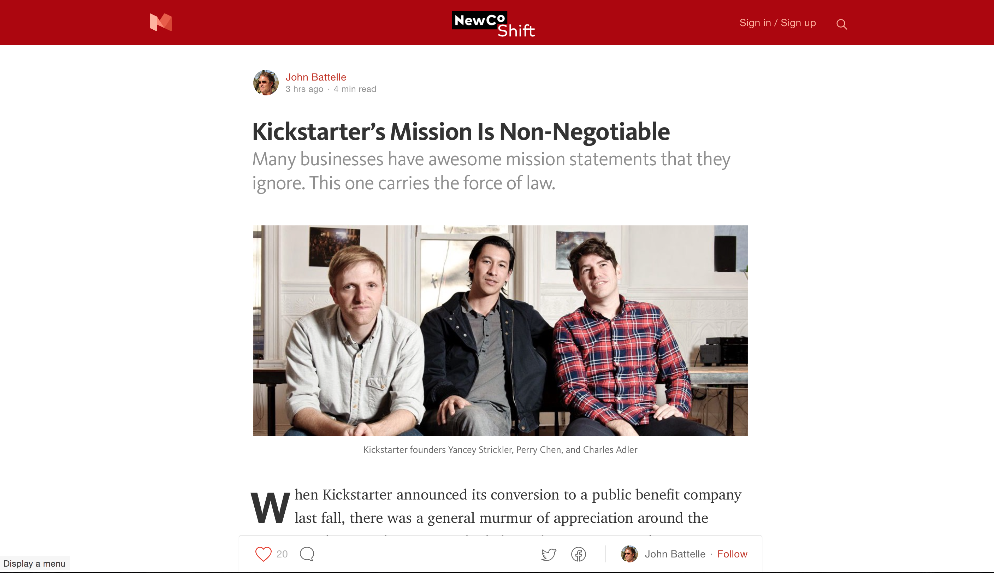
Use White Space to Improve Comprehension

Slide 19
What do you see?

Slide 20
Use White Space to Clarify Relationships
Forms: Place labels closest to relevant fields
Group related topics together

Slide 21
Use White Space to Clarify Relationships
Group related topics together - Compare these two:

Slide 22
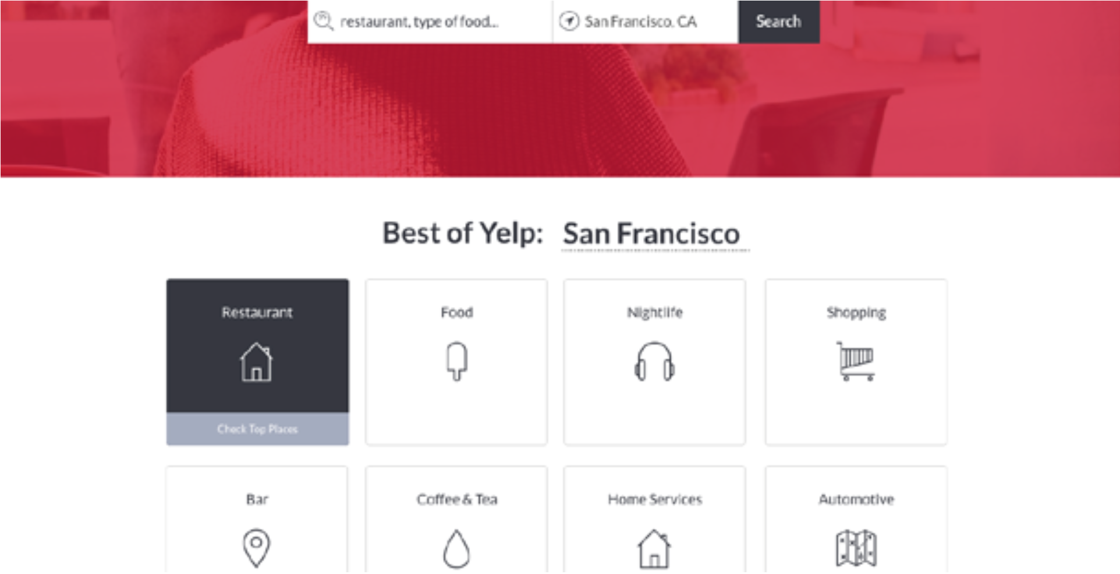
Use White Space to Attract Attention
The lack of other elements makes existing elements stand out more
Can be used instead of just making elements larger

Slide 23
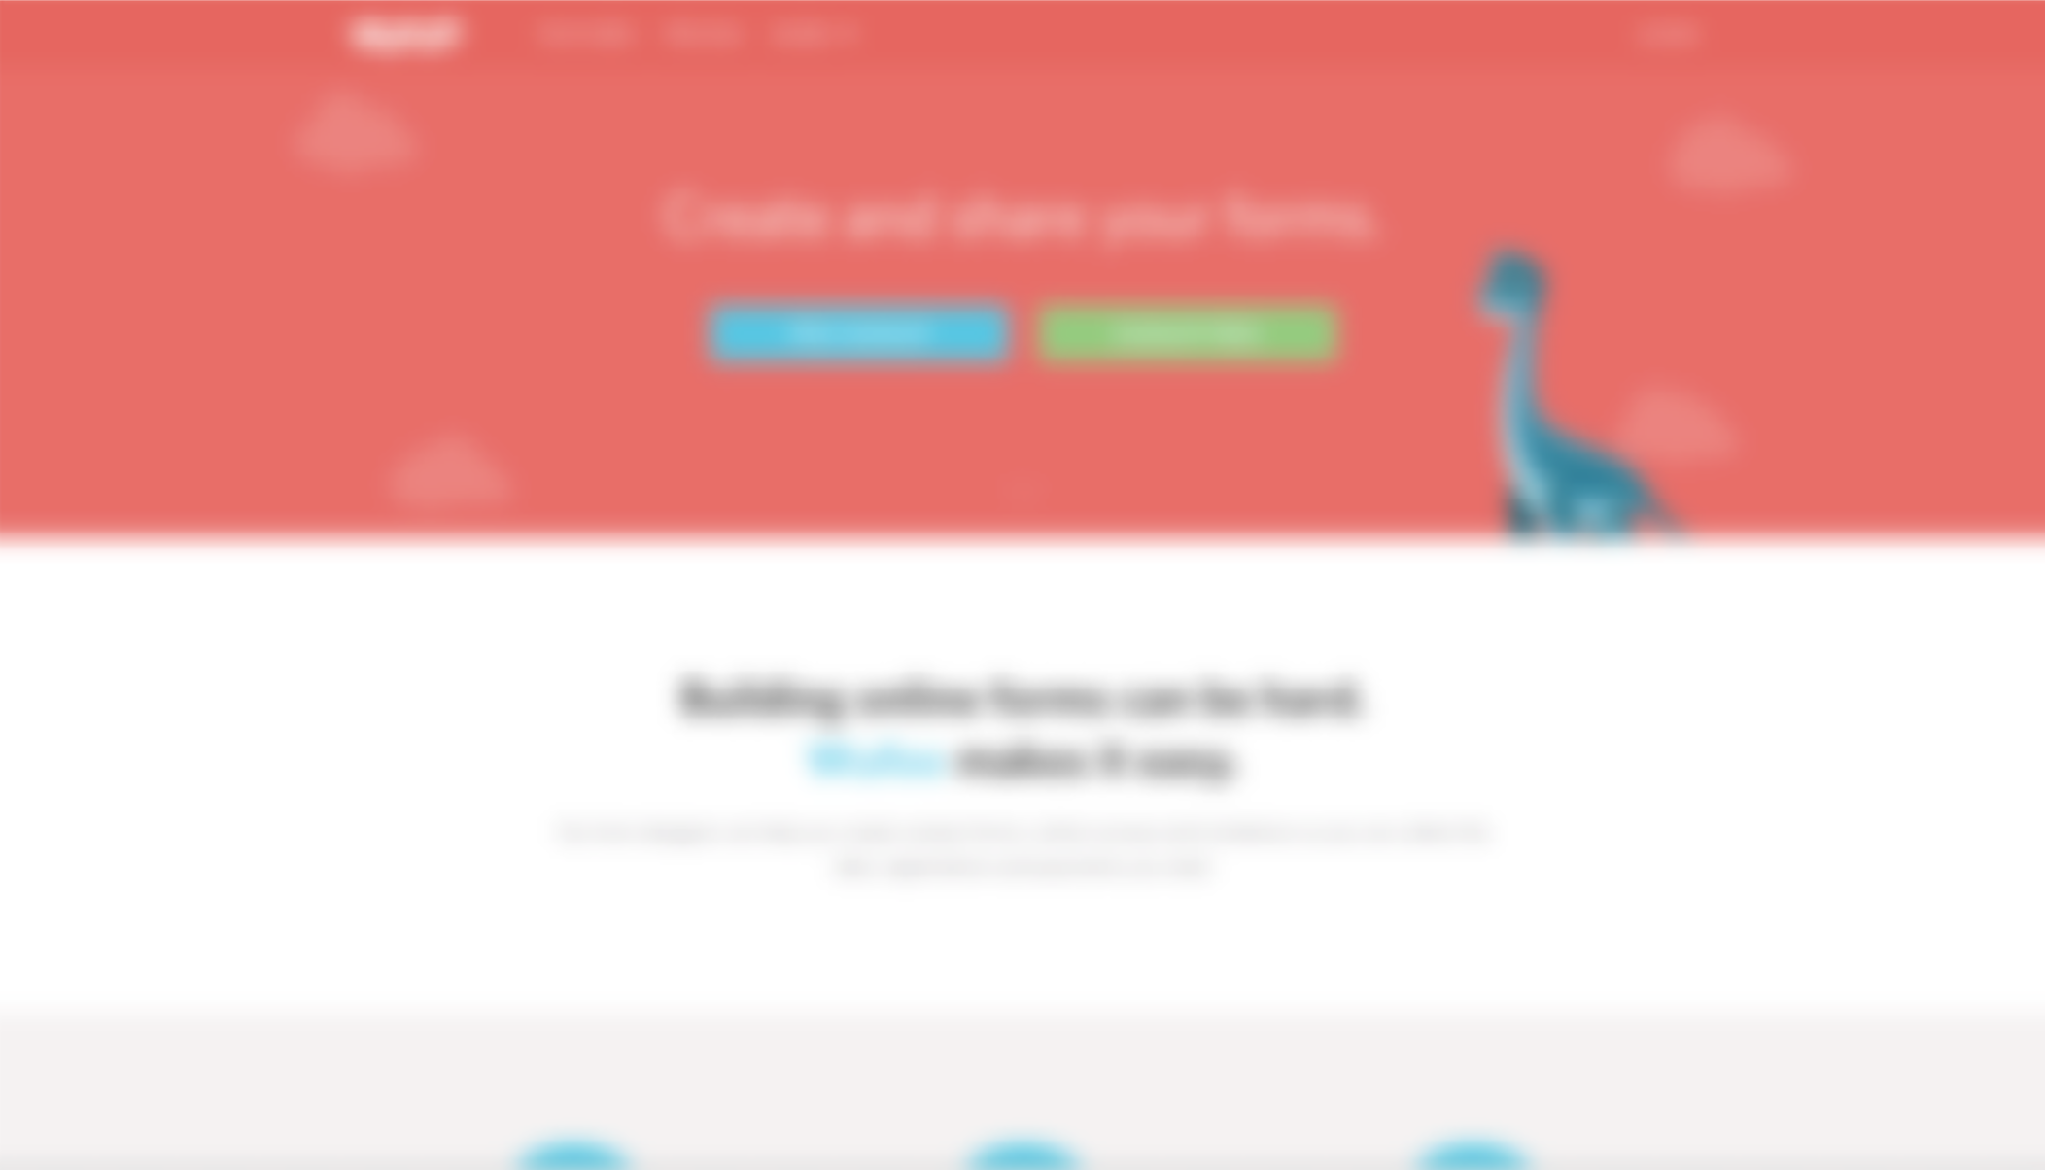
The 5-Second Test for Visual Hierarchy
Users form an opinion of your site within milliseconds (http://research.google.com/pubs/pub38315.html)
Blur Test - what stands out? Is it what we want standing out?
-webkit-filter: blur(5px)

Slide 24

Usability
Some of this lecture content comes from (CP1406):
Jakob Nielsen
"the world's leading expert on Web usability" (U.S. News & World Report)
useit.com
Usability is a quality attribute that assesses how easy user interfaces are to use. The word "usability" also refers to methods for improving ease-of-use during the design process.
http://www.useit.com/alertbox/20030825.html
Notes:
The next set of slides are from CP1406 so should be revision for students who've done that

Slide 25
Usability is defined by 5 quality components
Learnability: How easy is it for users to accomplish basic tasks the first time they encounter the design?
Efficiency: Once users have learned the design, how quickly can they perform tasks?
Memorability: When users return to the design after a period of not using it, how easily can they reestablish proficiency?
Errors: How many errors do users make, how severe are these errors, and how easily can they recover from the errors?
Satisfaction: How pleasant is it to use the design?

Slide 26
What is Important?
Utility - the design's functionality: Does it do what users need?
Usability and utility are equally important
Utility = whether it provides the features you need.
Usability = how easy & pleasant these features are to use.
Useful = usability + utility
Notes:
It matters little that something is easy if it's not what you want. It's also no good if the system can hypothetically do what you want, but you can't make it happen because the user interface is too difficult.

Slide 27
Why Do People Leave a Site?
If a website is difficult to use
If the home page fails to clearly state what a company offers and what users can do on the site
If users get lost on a website
If a website's information is hard to read or doesn't answer users' key questions
People don't read instruction manuals for websites.
There are plenty of other websites available.
Note: many student designs don't have any real "content" on the home page – just links to other pages. Provide some kind of "locating" text that helps new users know what the site is.

Slide 28
Usability Improvements: Results
Current best practices suggest spending about 10% of a project's budget on usability. This will more than double a website's quality metrics and nearly double an intranet's quality metrics.
Internal projects = cutting training budgets in half and doubling the number of transactions employees perform
External projects = doubling sales, doubling registered users or customer leads, or doubling another desired goal

Slide 29
Improving a Website's Success
Formula for website success is: B = V × C × L
B = amount of business done by the site
V = unique visitors coming to the site
C = conversion rate (the percentage of visitors who become customers)
L = loyalty rate (the degree to which customers return to conduct repeat business)
So how do we make a site more successful?
Notes:
Increase any one of V, C, or L

Slide 30
Test Your Website
There are different types of testing:
Functionality (Quality Assurance) Testing – where you check that the site does what it is supposed to do (checking for broken links, code errors etc.)
User Acceptance Testing – verify the result meets the agreed-on requirements (usually with client)
Usability Testing – determine how easy the site is to use; discover how the site aids or hinders people

Slide 31
Improve Usability by User Testing
Get some representative users, such as customers or employees (who work outside your department)
Ask the users to perform representative tasks with the design
Have them test a specific area of the site
Give them specific tasks, and give all users the same task so you have something to compare
You need a roll of duct tape and a pad and pen…
Who Are "Representative Users"?
Notes:
The duct tape is to go over your mouth, so you don’t guide or talk to you users; the pad & pen are for recording what they do during the tests.

Slide 32
Iterative Design & Testing
You don't want a big, expensive study
It is a better use of resources to run many small tests and revise the design between each one
so you can fix the usability flaws as you identify them
Testing 5 users is typically enough to identify a design's most important usability problems
Iterative design is the best way to increase the quality of the user experience
The more versions and interface ideas you test with users, the better

Slide 33
Iterative Design & Testing
Observe what the users do, where they succeed, and where they have difficulties with the user interface.
Shut up and let the users do the talking.
If possible, record the user's mouse movements and faces, so you can review the footage later
Systems exist for tracking eye movement for where users look on a page

Slide 34
Performing The Test
Encourage the user to "think-aloud", that is to tell you what they are thinking as they are performing the process... no matter how silly it seems to them
Facilitator ... "As you are working, please think out loud and describe what you are looking for, what questions you have, anything that surprises you, etc. I won't normally answer these questions for you but they will help us to understand how to make the site more user friendly"

Slide 35
When To Test?
Before starting the new design, test the old design
Test your competitors' designs
to get cheap data on a range of alternative interfaces that have similar features to your own.
Conduct a field study to see how users behave in their natural environment.
Make quick (paper?) prototypes of new design ideas and test them.
Refine the design ideas that test best through multiple iterations, testing each iteration.
Implement final design, test it again.

Slide 36
Summary
Understanding psychological principles about how people think and process visual information can help you design effective websites that are better at achieving their goals.
Use white space effectively to help users perceive your site content
Ensure that your visual hierarchy is clear and helpful
Perform iterative testing (including the blur test) to improve your designs
Always design with the user experience in mind

